Slide 1
Why visualise? Not Just a Pretty Picture
Robert M. Hanson
St. Olaf College
SMARTER 4 Conference
Durham, UK
Sept. 2, 2014

Slide 2
Graphical visualisation
0,1.00
0.500,1.04
1.000,1.09
1.500,1.13
2.000,1.18
2.500,1.22
3.000,1.27
3.500,1.32
4.000,1.37
4.500,1.42
5.000,1.48
5.500,1.54
6.000,1.60
6.500,1.67
7.000,1.75
7.500,1.85
8.000,1.95
8.500,2.09
9.000,2.28
9.500,2.59
10.000,7.00
10.500,11.39
11.000,11.68
11.500,11.84
12.000,11.96
12.500,12.05
13.000,12.12
13.500,12.17
14.000,12.22
14.500,12.26
15.000,12.30
15.500,12.33
16.000,12.36
16.500,12.39
17.000,12.41
17.500,12.44
18.000,12.46
18.500,12.47
19.000,12.49
19.500,12.51
20.000,12.52
What are we looking at?

Slide 3
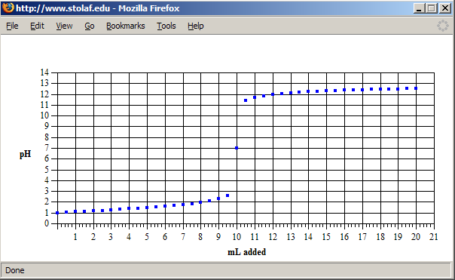
Graphical visualisation
A titration curve.

Slide 4
Graphical visualisation
time(sec) [NO2]
0 0.0100
50 0.0079
0.0065
0.0048
300 0.0038
What have we here?

Slide 5
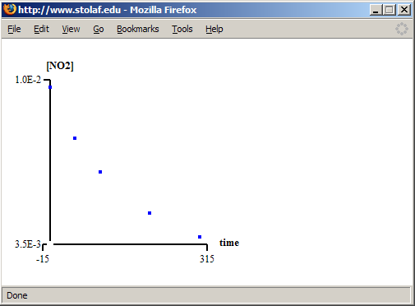
Graphical visualisation
Ah, yes, but what kind of reaction kinetics?

Slide 6
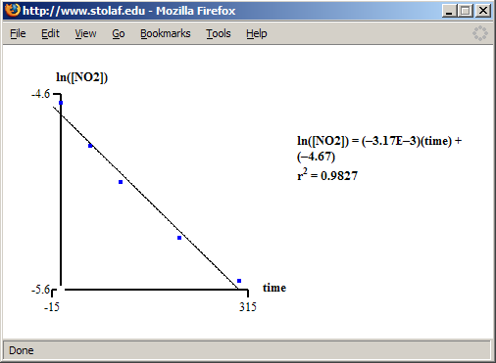
Graphical visualisation
Not first order…

Slide 7
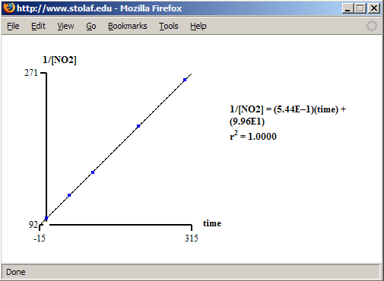
Graphical visualisation
Second order, it is!

Slide 8
Graphical visualisation
J. Willard Gibbs: “To fix our ideas, let the axes of ν, η, and ε have the directions usually given to the axes of X, Y, and Z (ν increasing to the right, η forward, and ε upward). The pressure and temperature of the state represented by any point of the surface are equal to the tangents of the inclinations of the surface to the horizon at that point, as measured in planes perpendicular to the axes of η and of ν, respectively….“
A Method of Geometrical Representation of the Thermodynamic Properties of Substances by Means of Surfaces Transactions of the Connecticut Academy, II, pp 382-404, Dec. 1873.

Slide 9
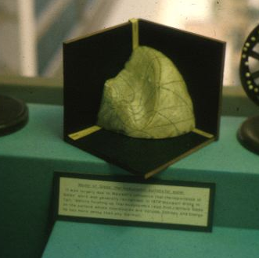
Graphical visualisation
Maxwell’s plaster model of Gibbs’s surface
Photo: Thomas G. West
http://krasnow.gmu.edu/twest/maxwell_visual.html
http://old.siggraph.org/publications/newsletter/v33n1/index.html

Slide 10
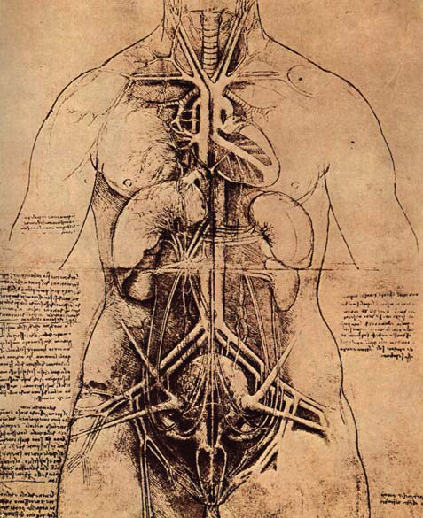
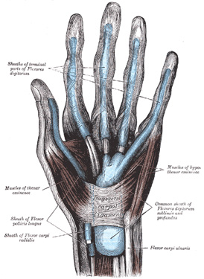
Medical visualisation

Slide 11
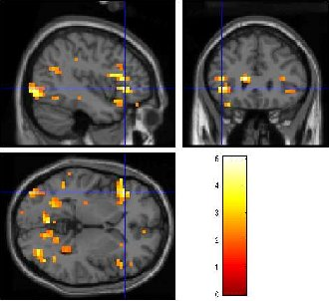
Medical visualisation

Slide 12

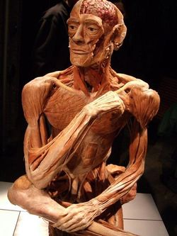
Körperwelten

Slide 13
The point?
Visualisation takes many forms.
Sometimes getting the right visualisation is critical.
Many amazing forms of visualisation are appearing.

Slide 14
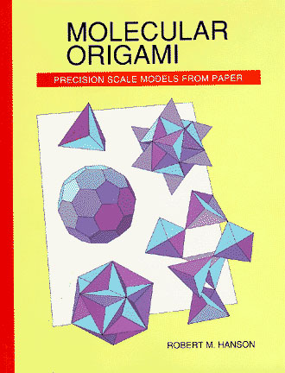
Molecular visualisation
http://www.uscibooks.com/hansonb.htm

Slide 15
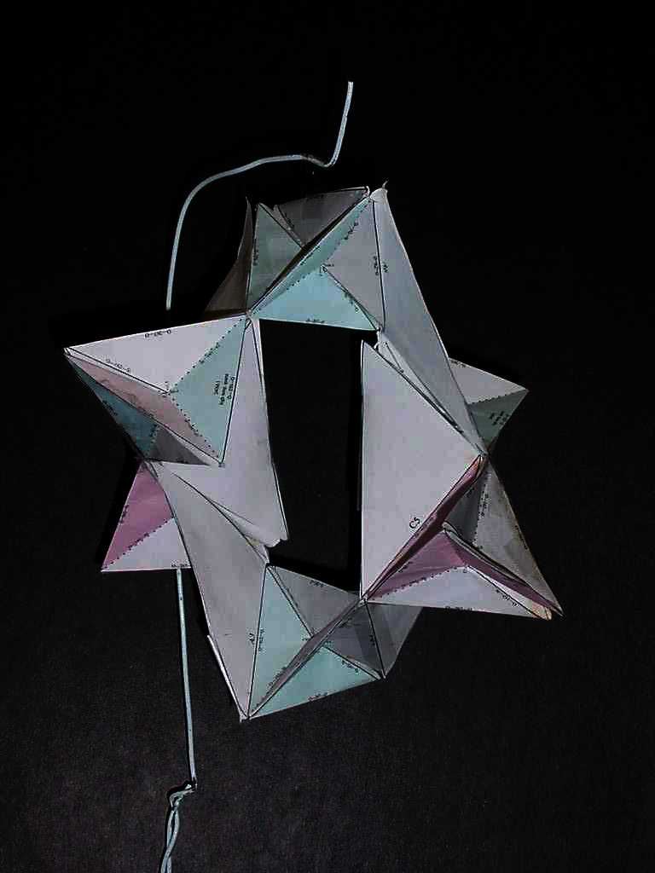
Molecular visualisation
quartz helix

Slide 16
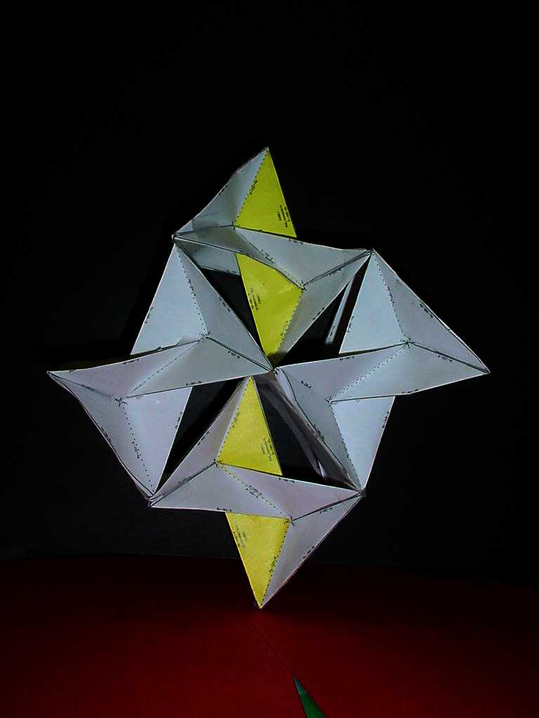
Molecular visualisation
marcasite

Slide 17
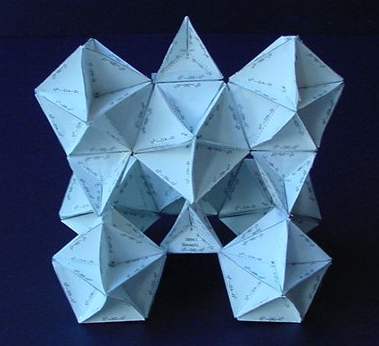
Molecular visualisation
zircon

Slide 18
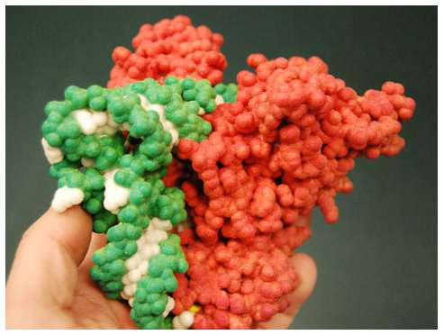
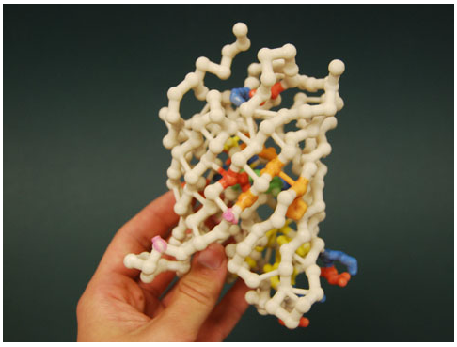
Molecular visualisation

Slide 19
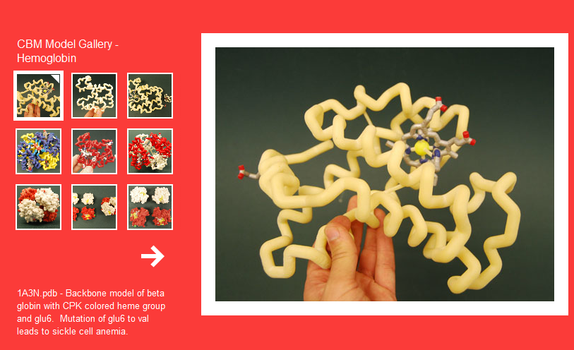

Slide 20
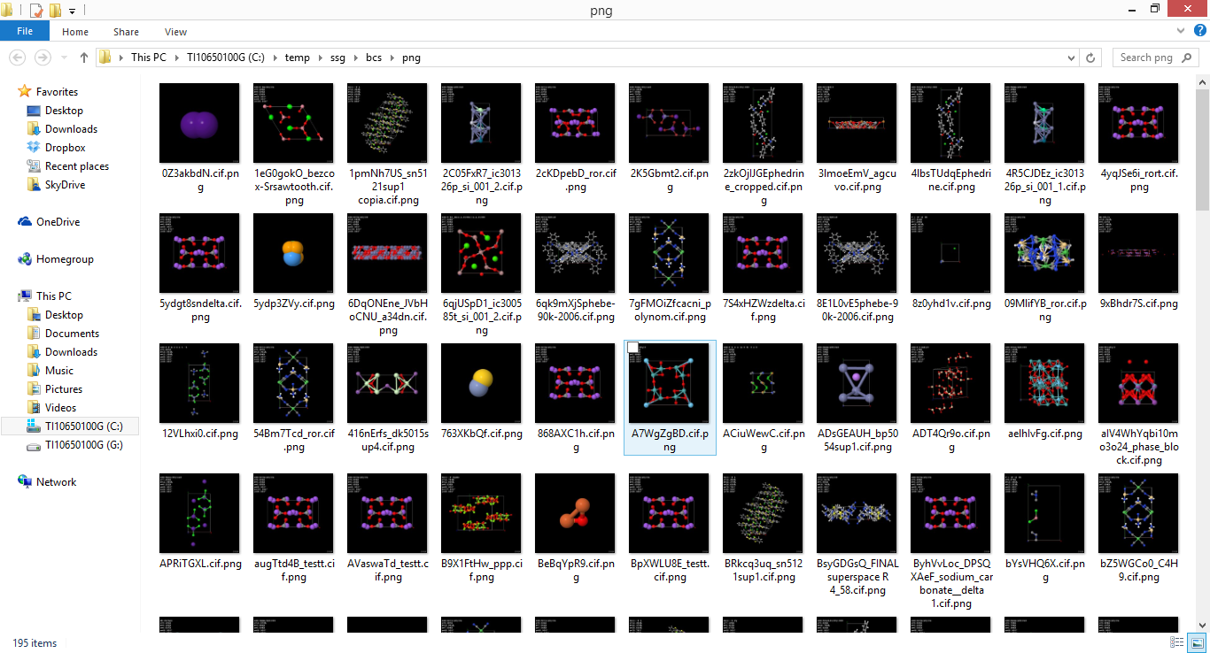
Visualization for communication/archiving
.

Slide 21
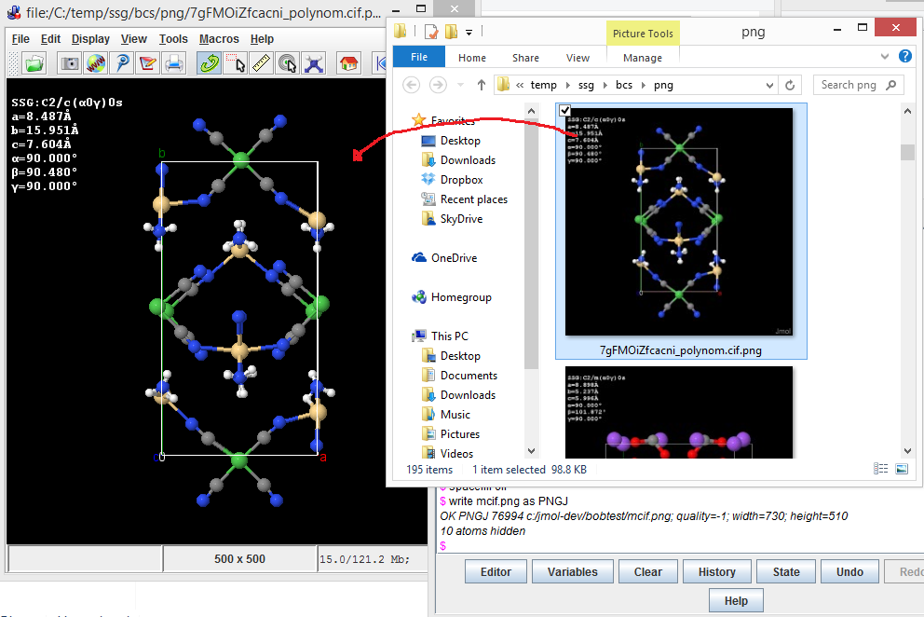
Visualization for communication/archiving
PNGJ image+model format
.

Slide 22
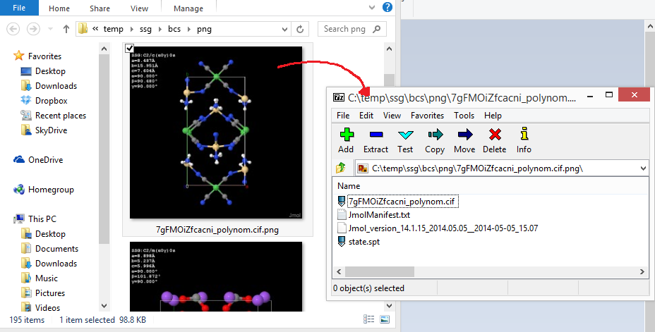
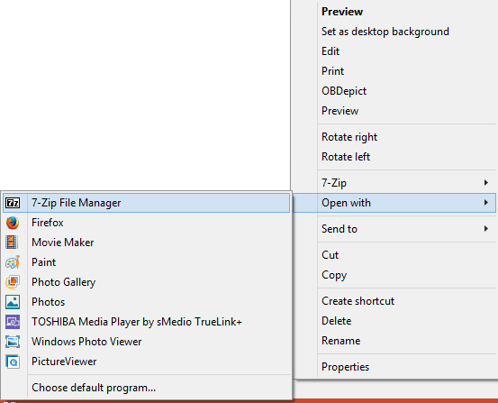
Visualization for communication/archiving
PNGJ image+model format – readable as ZIP file
.

Slide 23
Web-base molecular visualisation
Challenges include:
Realistic rendering
Speed
Scalability
Surface rendering

Slide 24
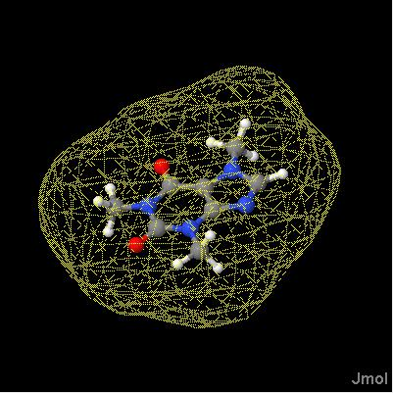
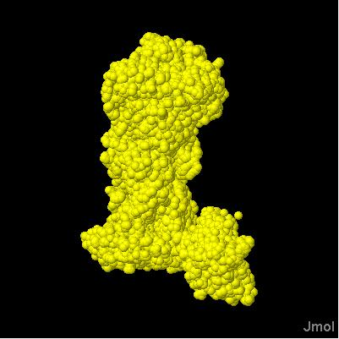
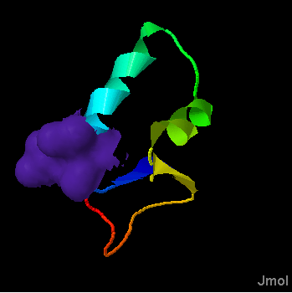
Web-base molecular visualisation
Applications of isosurfaces:
molecular surfaces

Slide 25
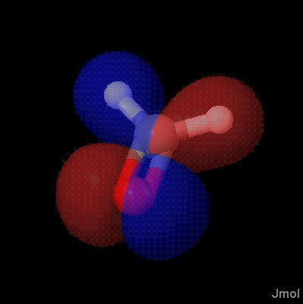
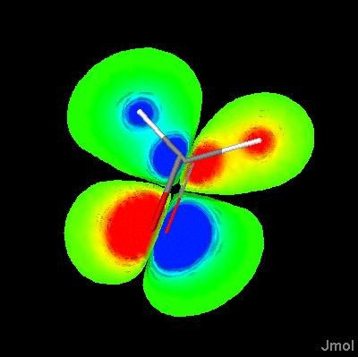
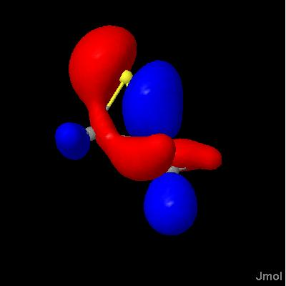
Web-base molecular visualisation
Applications of isosurfaces:
molecular orbitals

Slide 26
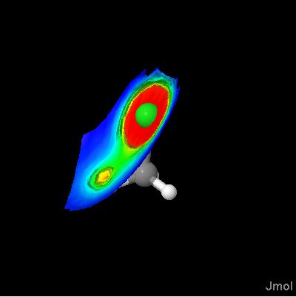
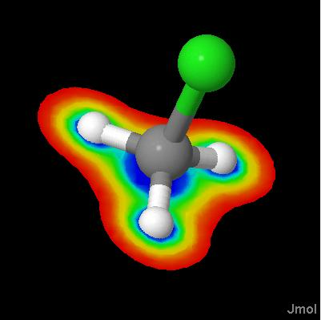
Web-base molecular visualisation
Applications of isosurfaces:
potential maps

Slide 27
Web-base molecular visualisation
Applications of isosurfaces:
Fermi surfaces

Slide 28
Web-base molecular visualisation
Applications of isosurfaces:
Fermi surfaces

Slide 29
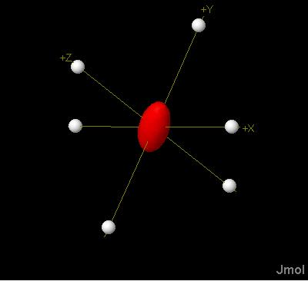

Web-base molecular visualisation
Applications of isosurfaces:
custom ellipsoids and
tensors

Slide 30
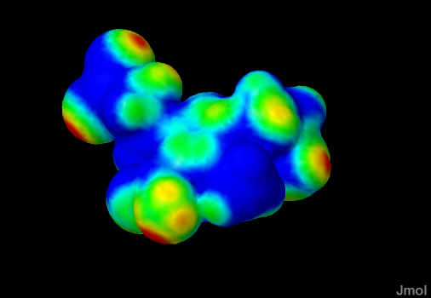
Web-base molecular visualisation
Applications of isosurfaces:
contacts

Slide 31
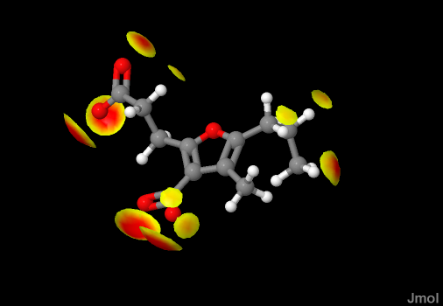
Web-base molecular visualisation
Applications of isosurfaces:
contacts

Slide 32
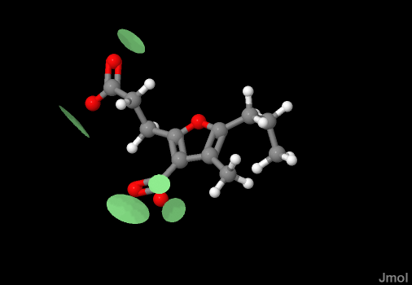
Web-base molecular visualisation
Applications of isosurfaces:
contacts

Slide 33
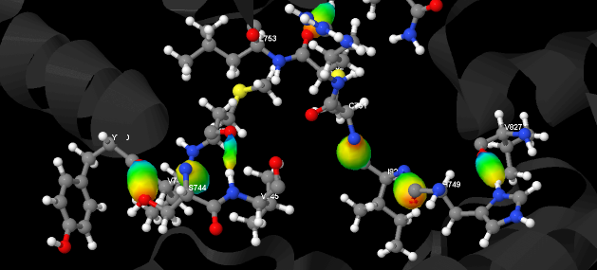
Web-base molecular visualisation
Applications of isosurfaces:
contacts

Slide 34
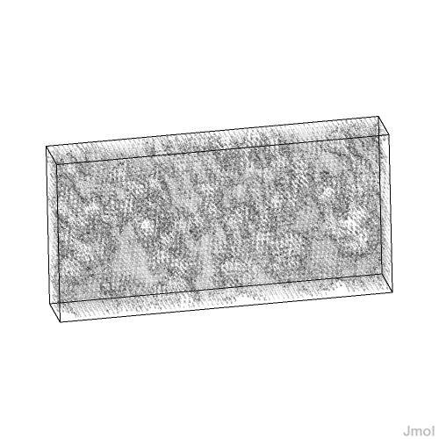
Crystallographic visualisation
Applications of isosurfaces:
electron density
Show actual crystallographic electron density data, and allow for dynamic clipping based on sigma values.

Slide 35
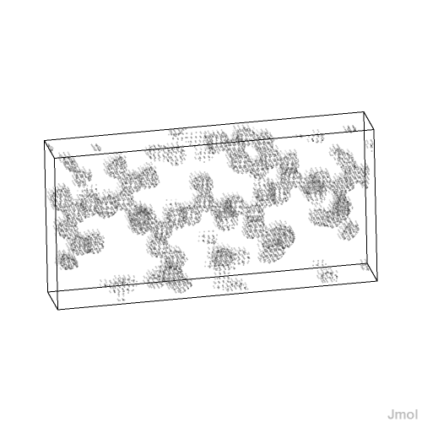
Crystallographic visualisation
Applications of isosurfaces:
electron density
Show actual crystallographic electron density data, and allow for dynamic clipping based on sigma values.

Slide 36
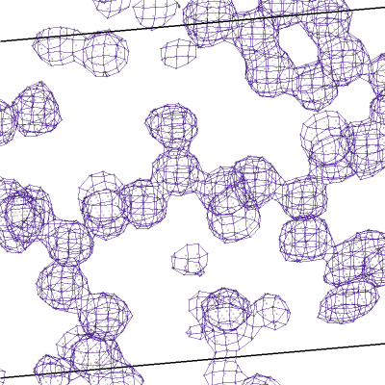
Crystallographic visualisation
Applications of isosurfaces:
electron density
Show actual crystallographic electron density data, and allow for dynamic clipping based on sigma values.

Slide 37
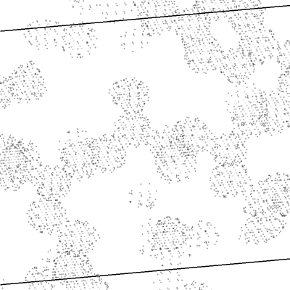
Crystallographic visualisation
Applications of isosurfaces:
electron density
Show actual crystallographic electron density data, and allow for dynamic clipping based on sigma values.

Slide 38
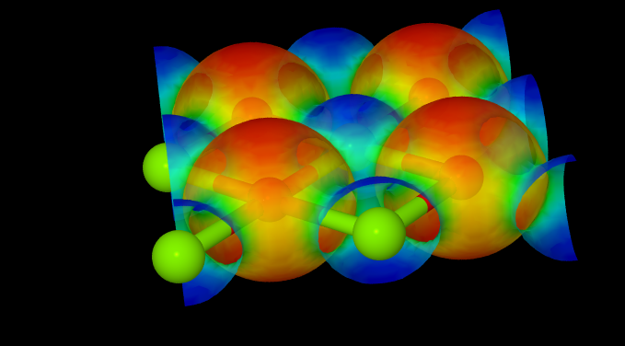
Crystallographic visualisation
Periodic isosurface creation

Slide 39
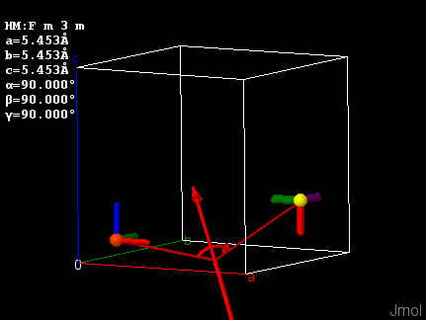
Crystallographic visualisation
Symmetry Depiction
… draw symop @1 @10

Slide 40
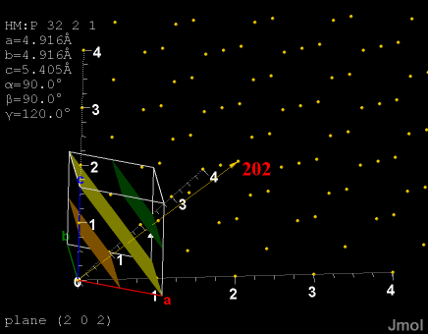
Crystallographic visualisation
Miller plane families

Slide 41
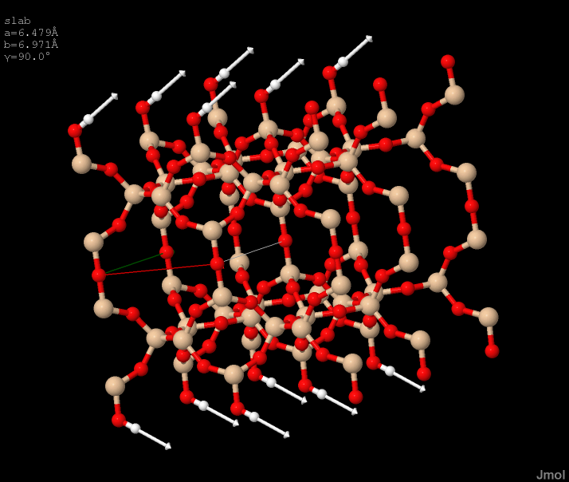
Crystallographic visualisation
Vibrational/phonon mode visualization

Slide 42
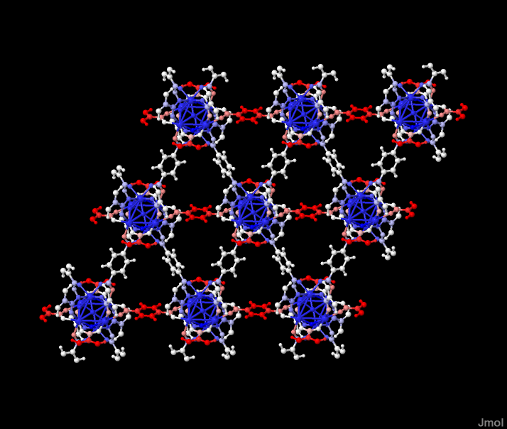
Crystallographic visualisation
Vibrational/phonon mode visualization

Slide 43
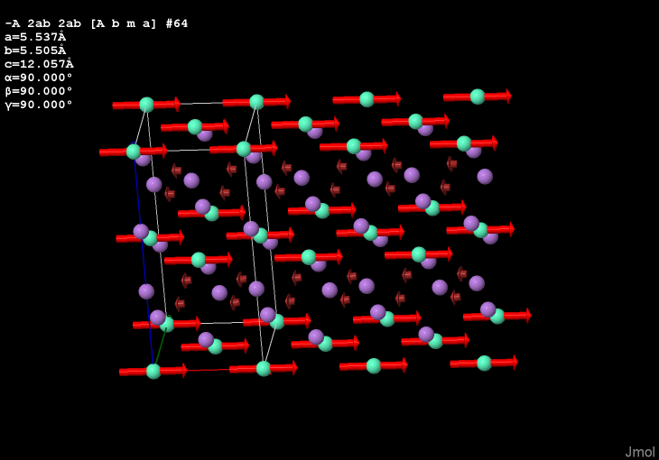
Crystallographic visualisation
mCIF file reading with vector display

Slide 44
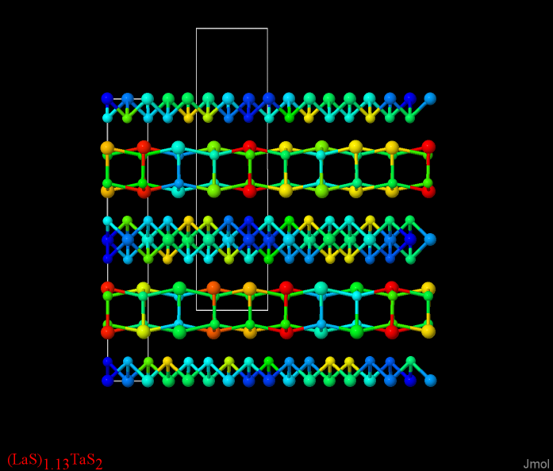
Crystallographic visualisation
Incommensurately modulated structures

Slide 45
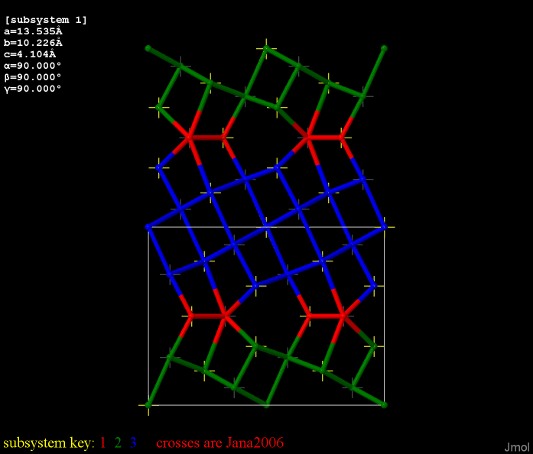
Crystallographic visualisation
Commensurate Subsystems

Slide 46
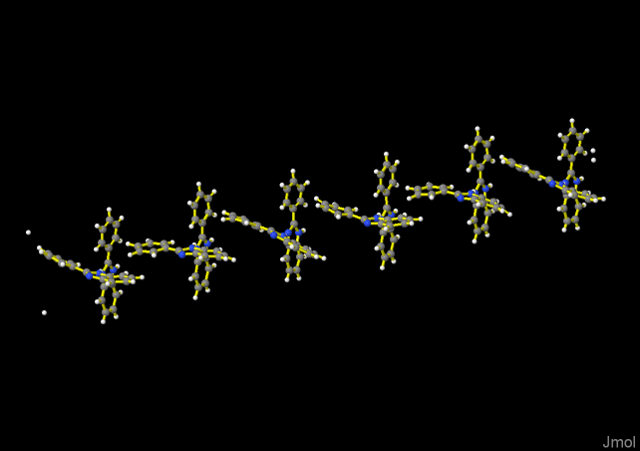
Crystallographic visualisation
Incommensurately modulated structures

Slide 47
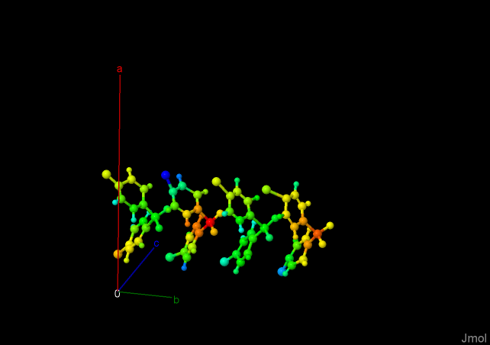
Crystallographic visualisation
Incommensurately modulated structures

Slide 48
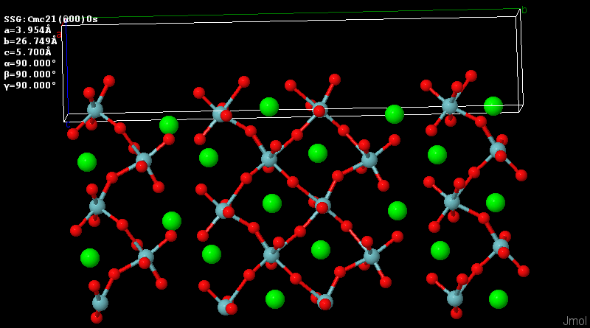
Crystallographic visualisation
Incommensurately modulated structures

Slide 49
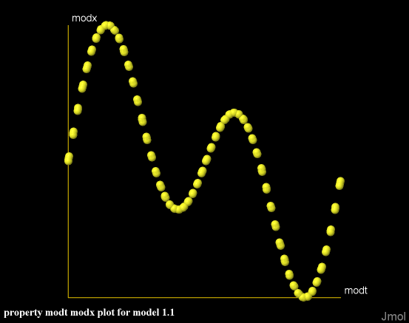
Crystallographic visualisation
select S1; plot properties modt modx

Slide 50
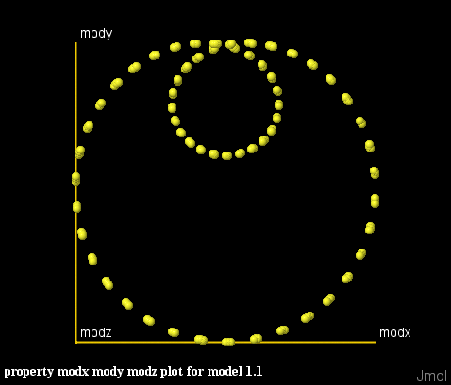
Crystallographic visualisation
select S1; plot properties modx mody modz

Slide 51

Recent Work – Incom. Magnetic Structures
2014.08.09

Slide 52

Recent Work – Incom. Magnetic Structures
2014.08.09

Slide 53

Recent Work – Incom. Magnetic Structures
2014.08.09

Slide 54

Recent Work – Incom. Magnetic Structures
2014.08.09 – http://b-incstrdb.ehu.es/incstrdb

Slide 55

Simone Sturniolo, U. of Oxford, http://ccpforge.cse.rl.ac.uk/gf/project/magresview/wiki

Slide 56

Recent Work – Phase Changes
2014.05.13

Slide 57
Summary
Visualisation is important both in teaching and research.
Sometimes getting the right visualisation is critical.
Good visualisations can lead to new insights and drive research and discovery.

Slide 58
Summary
Future developments in crystallography will require new forms of visualisation.
We need to push the limits to see what sort of new visualisations we can develop.
Do not just settle for what you have now.

Slide 59
Summary
Future developments in crystallography will require new forms of visualisation.
We need to push the limits to see what sort of new visualisations we can develop.
Do not just settle for what you have now.
Count me in! ---- THANK YOU!

